Slide 1
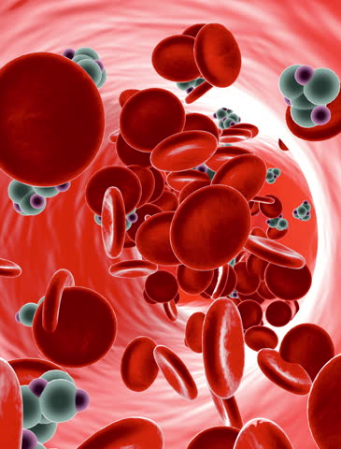
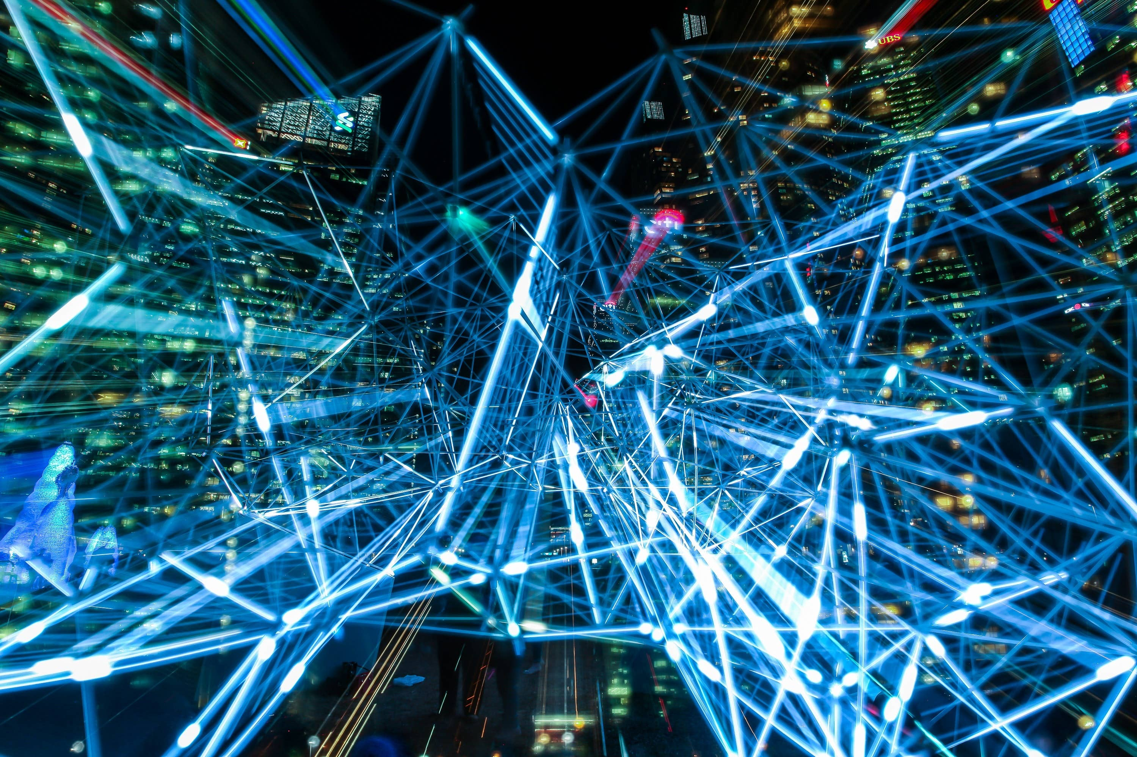
Physics Informed Neural Networks for Fluid Dynamics
NAPDE Course Project
Tutors: Stefano Pagani, Francesco Regazzoni
Students: Giulia Mescolini, Luca Sosta

Slide 2
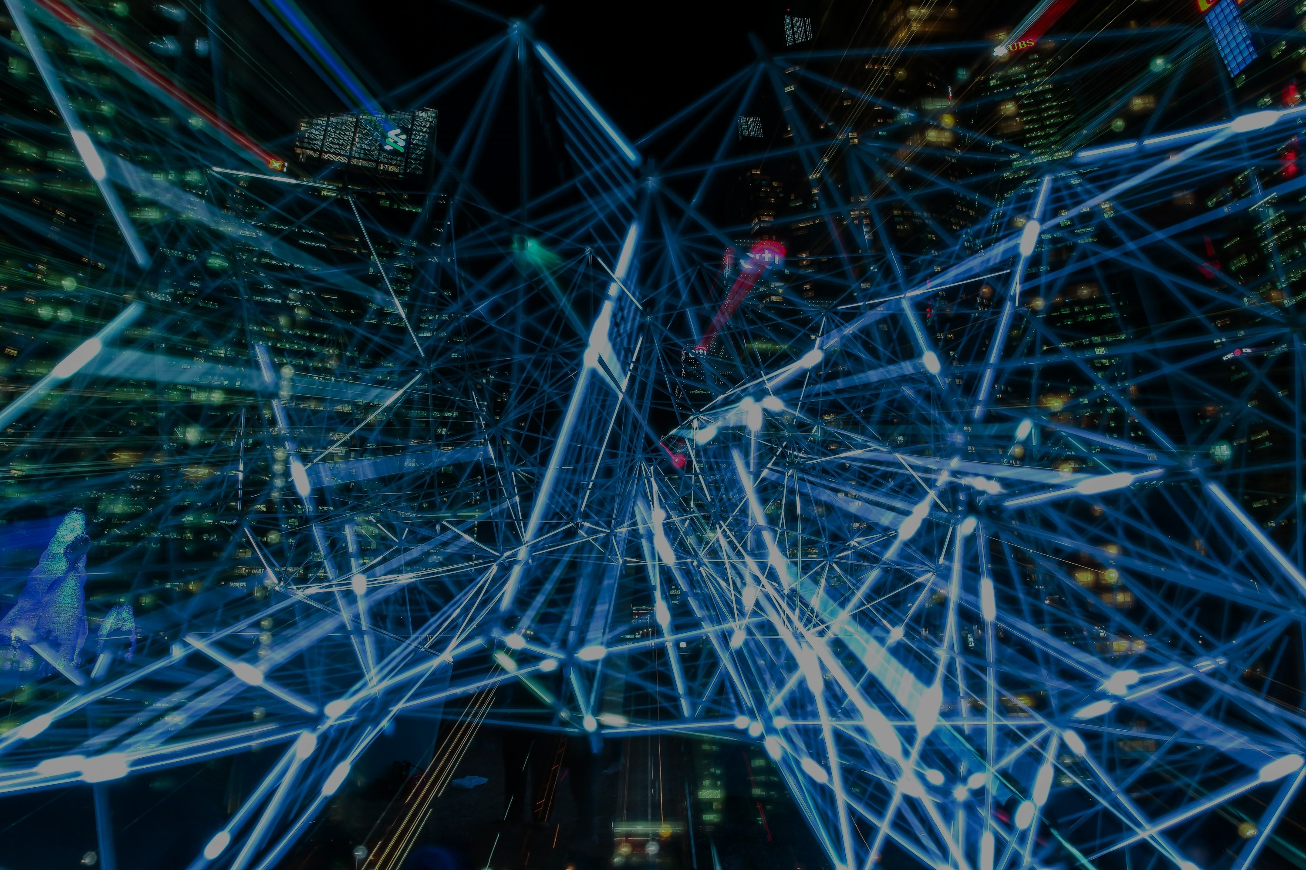
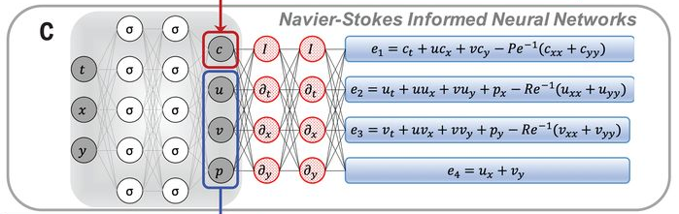
The idea
In the Fluid Dynamics framework we often meet problems involving PDEs which cannot be solved analitically.
A rising computational technique employs Neural Networks to reconstruct pressure and velocity of the fluid, the main unknowns in this field.

Slide 3
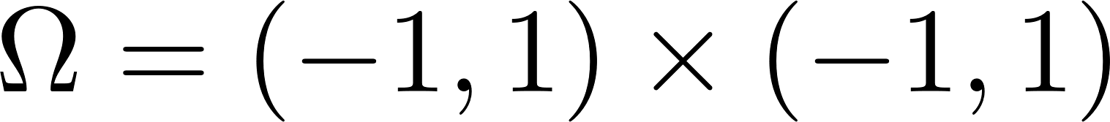
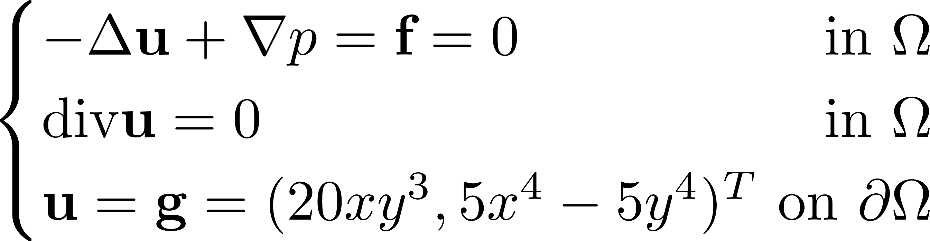

A simple test case
Reconstructing the pressure is the main difficulty, since it is difficult to have its measures; for this reason, we started from the Colliding Flows benchmark case, whose analytical solution is known, and trained our Neural Network giving only the information on the mean value of the pressure.
The reference library for the automatic differentiation is nisaba, a Python Library built on the top of Tensorflow.
nisaba

Slide 4
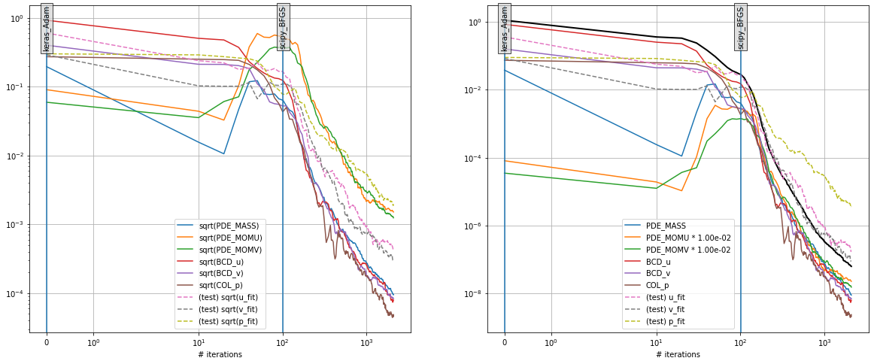
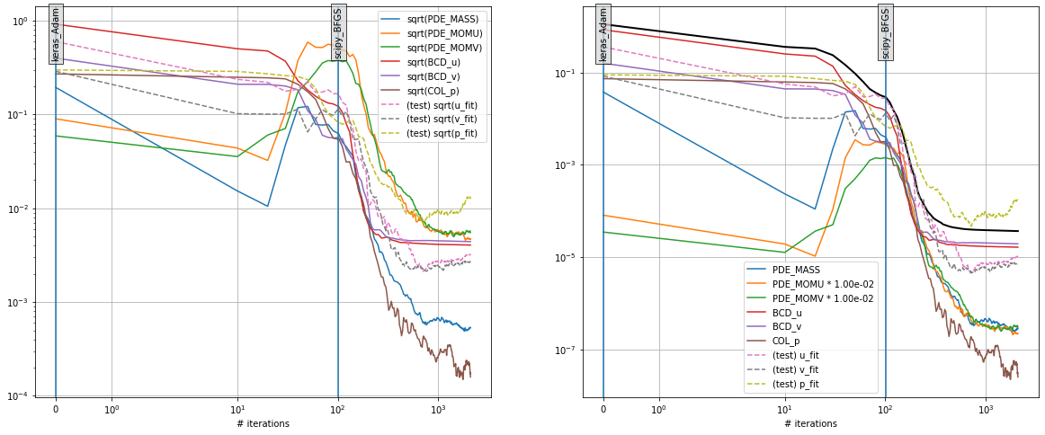
The results
2000 epochs, no noise on data
2000 epochs, with noise on data

Slide 5
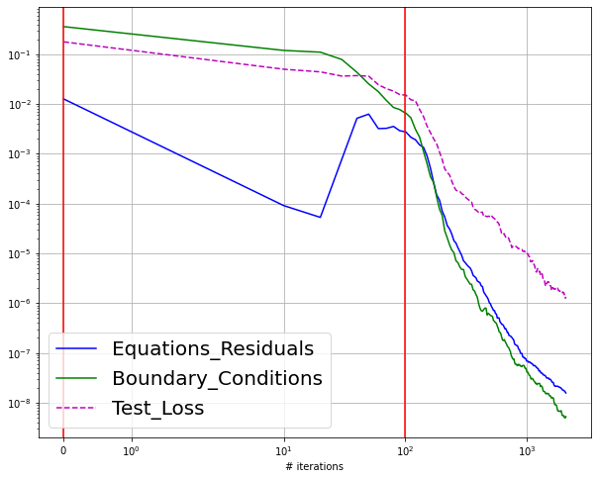
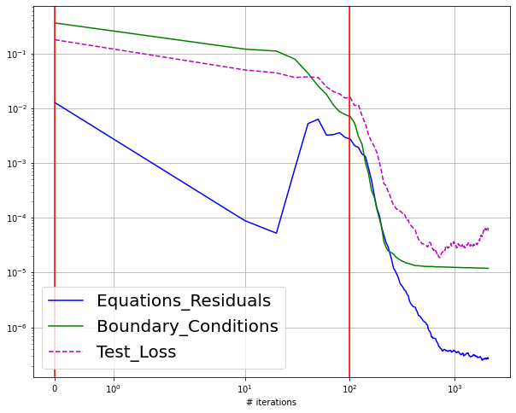
The results
2000 epochs, no noise on data
2000 epochs, with noise on data

Slide 6
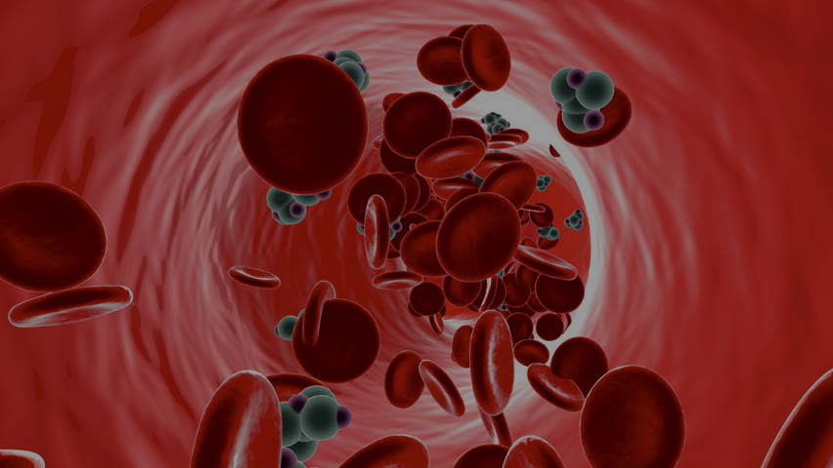
Our prospect
Our goal is to apply this strategy to a complex, real problem: the Coronary Flow Assessment, fundamental to evaluate coronary artery disease. In this case, there is no hope for an analytical solution!
In recent papers, it has been shown that ML algorithms provide information in a more reproducible manner and with improved diagnostic accuracy in comparison to the traditional methods.

Slide 7
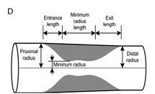
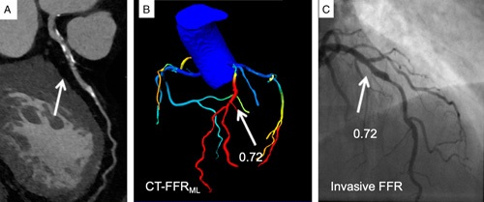
Work Plan
To train our Neural Network, we plan to exploit two types of information:
Geometrical Data
(eg: branch length, vessel radius…)
Data on velocity (provided by medical imaging)

Slide 8
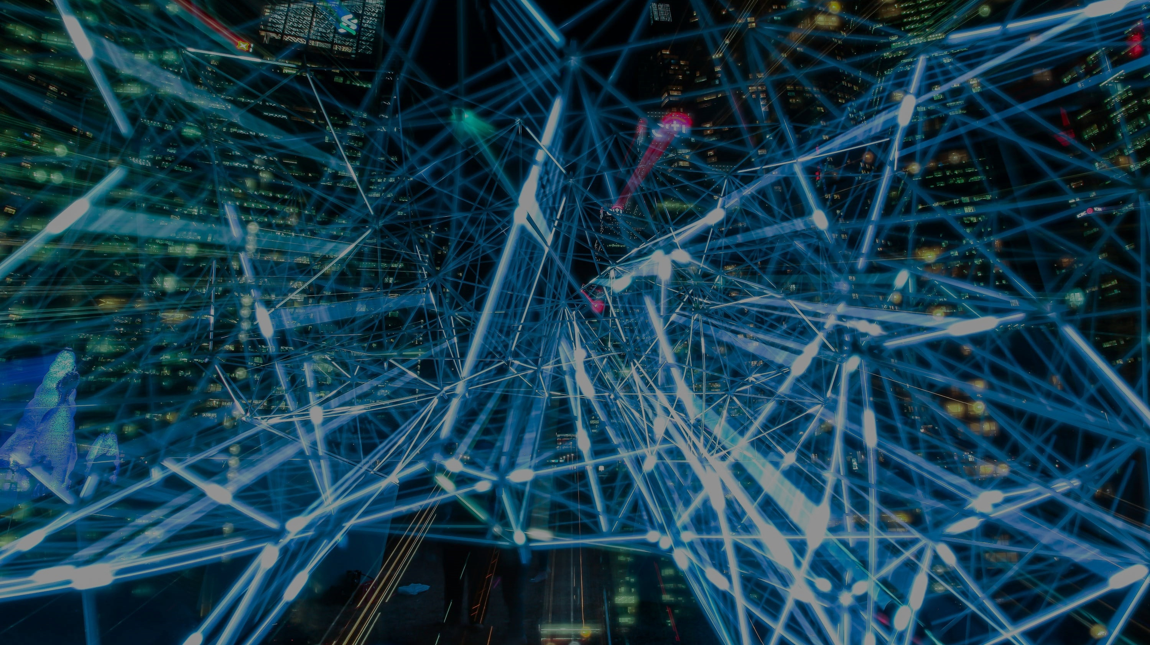
Thank you for your attention!

